Slide 1

Linear Models: Linear and Logistic Regression
Applied Machine Learning Derek Hoiem
Dall-E

Slide 2
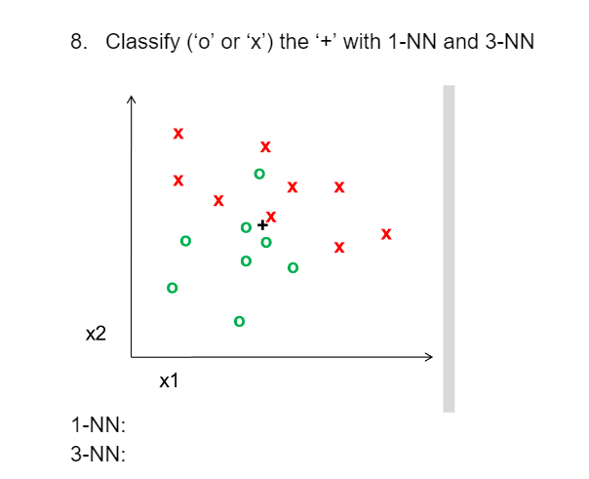
Brief review
Which of these tend to be decreased as the number of training examples increases?
Training error
Test error
Generalization error

Slide 3
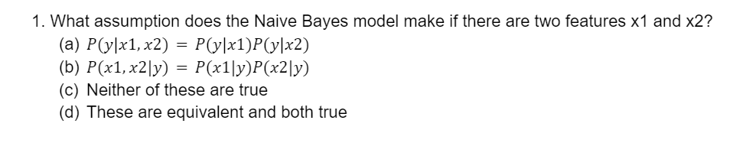
Brief Review
2. X1 and x2 are binary features, and y is a binary label:
P(x1=1 | y=0) = 2/3
P(x2=1 | y=0) = 1/3
P(x1=1 | y=1) = ¼
P(x2=1 | y=1) = ½
P(y=1) = 0.5
Under Naïve Bayes assumption, what is P(y=1 | x1=1, x2=1)?
Under Naïve Bayes assumption, is it possible to calculate P(y=1 | x1=0, x2=0)?
Without the Naïve Bayes assumption, is it possible to calculate P(y=1 | x1=1, x2=1)?

Slide 4
Today’s Lecture
Linear models: linear logistic regression and linear regression
What are the models
How to train
How to evaluate
When to use them
Regularization
How it affects weights
How to solve for regularization parameters

Slide 5


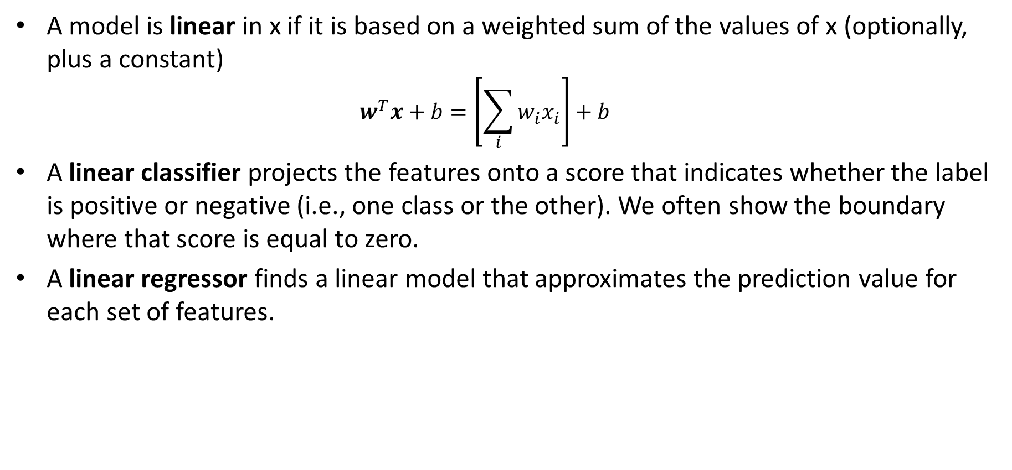

Linear Models
A model is linear in x if it is based on a weighted sum of the values of x (optionally, plus a constant)
$$w^{T}x+b=\left[\sum_{i}{w_{i}x_{i}}\right]+b$$
A linear classifier projects the features onto a score that indicates whether the label is positive or negative (i.e., one class or the other). We often show the boundary where that score is equal to zero.
A linear regressor finds a linear model that approximates the prediction value for each set of features.
.
.
.
Target ($y$)
.
$$y=w^{T}x+b$$
$$score\left(y=1\right)=w^{T}x+b$$
Feature ($x$)
$w^{T}x+b$=0

Slide 6
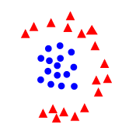

Linear Classifiers and Linear Separability
Linear classifier: $y=1 if w^{T}x+b>0$
Linearly separable: a line (or hyperplane) in feature space can split the two labels
Which of these are linearly separable?

Slide 7
Linear Classifiers and Linear Separability
In high dimensions, a lot more things are linearly separable
If you have D dimensions, you can separate D+1 points with any arbitrary labeling
1D
2D
x
o
Separable
Not Separable
Separable
o
x
o
x
Not Separable
o
x
o
x
o
o

Slide 8
Linear Classifiers and Linear Separability
But how do you choose which line is best?
Different classifiers use different objectives to choose the line

Slide 9
Linear Classifiers and Linear Separability
Different classifiers use different objectives to choose the line
Common principles are that you want training samples on the correct side of the line (low classification error) by some margin (high confidence)
Thick line is better classification function than thin line because all the examples have a good margin

Slide 10
(Linear) Logistic Regression Model
“Logistic function”
* To simplify notation, I may omit the “b”, which can be avoided by adding a “1” to each feature vector
“Logit”
LLR vs. Naïve Bayes
For many probability functions (exponential family, which includes binomial and Gaussian), Naïve Bayes predictor is also linear in x, but the parameters are independently estimated per feature
The logistic regression model is typically more expressive than Naïve Bayes
Logistic regression directly fits a discriminative function (i.e. f(x)→y) rather than trying to model P(x|y)

Slide 11
Linear Logistic Regression
The further you are from the line, the more confident in a label
P(circle|x) is higher
P(triangle|x) is higher
P(circle|x)=P(triangle|x) on the line

Slide 12

Linear Logistic Regression algorithm
Training
$w^{∗}=\underset{w}{argmin}{−\sum_{n}{log P\left({y=y}_{n}\right|x_{n};w)+r(w)}}$
Prediction
$y=1$ if $w^{T}x>0$
$P\left(y=1 | x\right)=\frac{1}{1+\exp\left(−w^{T}x\right)}=\frac{\exp\left(w^{T}x\right)}{\exp\left(w^{T}x\right)+1}$
$P\left(y=k | x\right)=\frac{\exp\left(w_{k}^{T}x\right)}{\sum_{j}{\exp\left(w_{j}^{T}x\right)}}$
regularization
log probability of all labels given features, assuming that each example is i.i.d.
Binary (two-class) case
Multiclass case (one w per class)

Slide 13
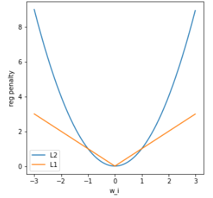

Training Logistic Regression
$w^{∗}=\underset{w}{argmin}{−\sum_{n}{log P_{w}\left(y=y_{n}\right|x_{n})+r(w)}}$
L2 regularization: $r\left(w\right)=λ{\left\|w\right\|}_{2}^{2}=λ\sum_{i}{w_{i}^{2}}$
L1 regularization: $r\left(w\right)=λ{\left\|w\right\|}_{1}=λ\sum_{i}{|w_{i}|}$
L2 wants no really big weights
L1 does not want a lot of little weights
L1 leads to a sparse weight vector (many zeros) – why?
L1 regularization can be used to select features!
When is regularization absolutely essential?
There are many optimizers for L2 and L1 logistic regression. You will want to use a library.

Slide 14

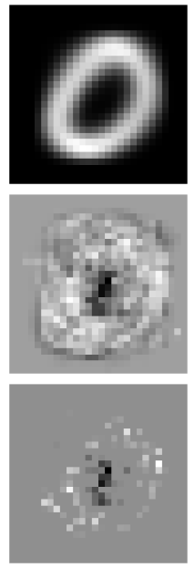
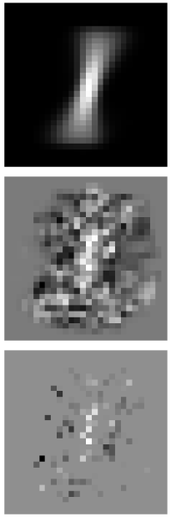
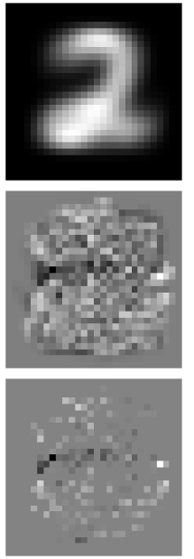
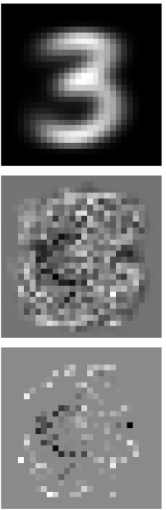
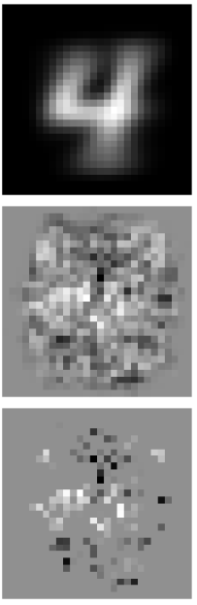
Inspecting weights for digits
Average Pixels
L2 weights
L1 weights

Slide 15

How to perform model selection for hyperparameters
“Hyperparameters” are part of the objective function, not something that training data can fit.
E.g., the regularization weight $λ$ is a hyperparameter

Slide 16
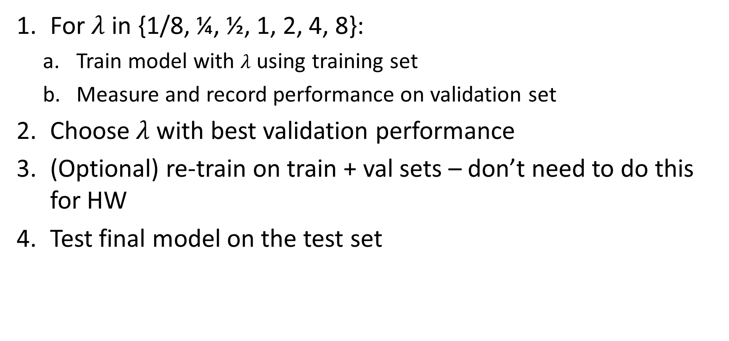
How to perform model selection for hyperparameters
For $λ$ in {1/8, ¼, ½, 1, 2, 4, 8}:
Train model with $λ$ using training set
Measure and record performance on validation set
Choose $λ$ with best validation performance
(Optional) re-train on train + val sets – don’t need to do this for HW
Test final model on the test set
Tips
In many cases, you want to vary parameters by factors, e.g. times 2 or times 5 for each candidate
You can start search broad and then narrow, e.g. if ¼ and ½ are the best two, then try 3/8
If you are searching over many parameters simultaneously, then it’s better to randomly sample candidate parameter values

Slide 17
Other forms of hyper-parameter selection
Cross-validation
Split training set into 5 parts
Train on 4/5 and train on remaining fifth
Repeat five times, using a different fifth for validation each time
Choose hyperparameters based on average validation performance
Useful when you have limited training data
Leave-one-out cross-validation (LOOCV) is an extreme where for N data points, you have N splits (one held out for validation each time)

Slide 18
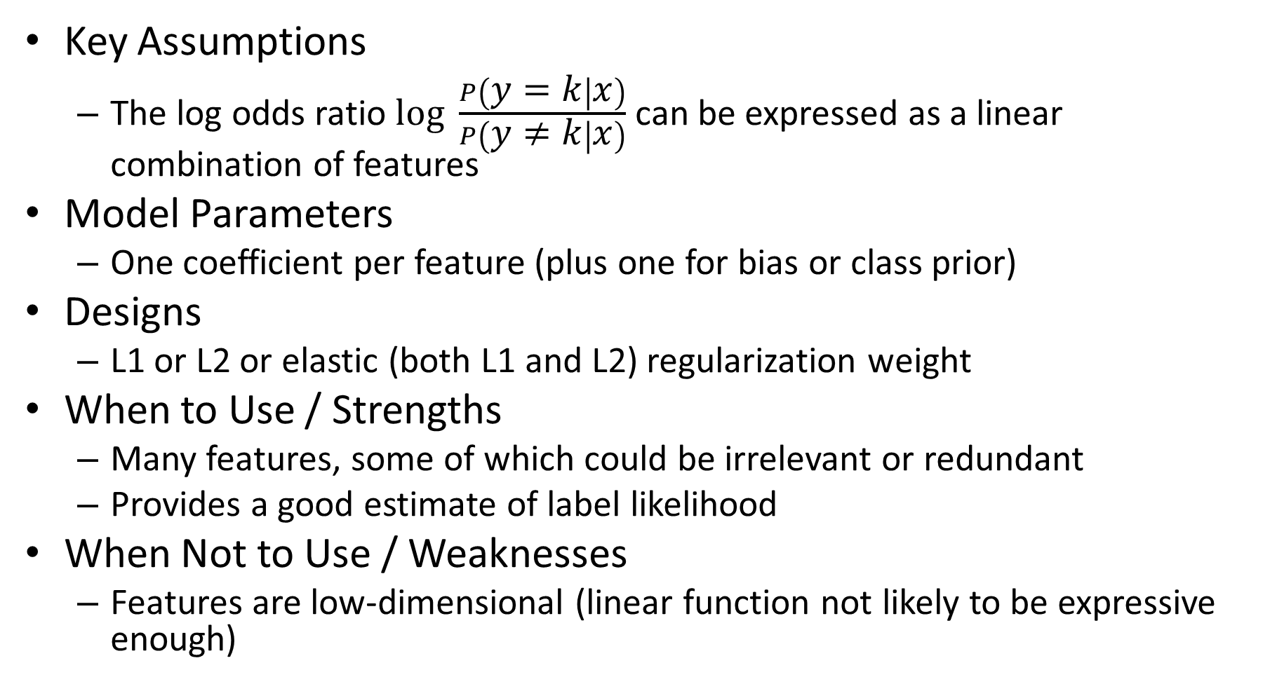
Logistic Regression Summary
Key Assumptions
The log odds ratio $log \frac{P\left(y=k | x\right)}{P\left(y≠k | x\right)}$ can be expressed as a linear combination of features
Model Parameters
One coefficient per feature (plus one for bias or class prior)
Designs
L1 or L2 or elastic (both L1 and L2) regularization weight
When to Use / Strengths
Many features, some of which could be irrelevant or redundant
Provides a good estimate of label likelihood
When Not to Use / Weaknesses
Features are low-dimensional (linear function not likely to be expressive enough)

Slide 19
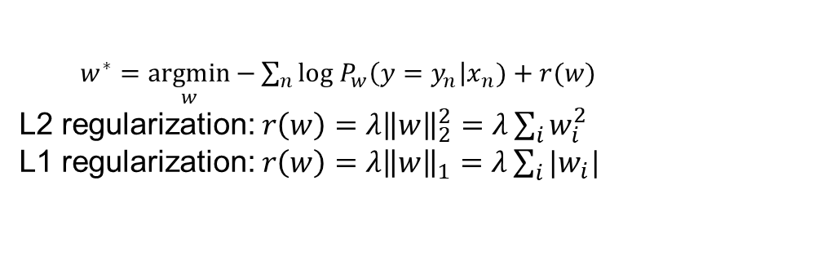
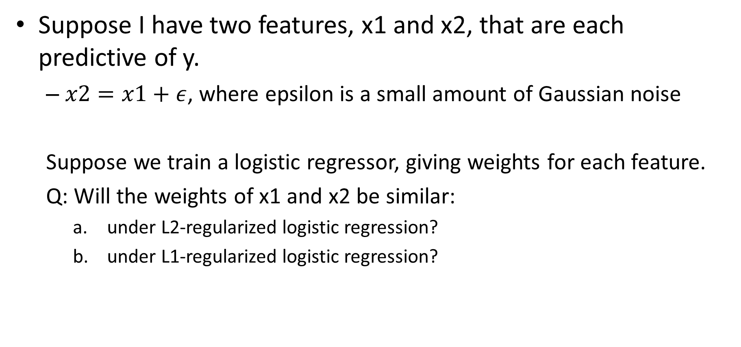
Pause (2 min) and think/stretch
Suppose I have two features, x1 and x2, that are each predictive of y.
$x2=x1+ε$, where epsilon is a small amount of Gaussian noise
Suppose we train a logistic regressor, giving weights for each feature.
Q: Will the weights of x1 and x2 be similar:
under L2-regularized logistic regression?
under L1-regularized logistic regression?
$w^{∗}=\underset{w}{argmin}{−\sum_{n}{log P_{w}\left(y=y_{n}\right|x_{n})+r(w)}}$
L2 regularization: $r\left(w\right)=λ{\left\|w\right\|}_{2}^{2}=λ\sum_{i}{w_{i}^{2}}$
L1 regularization: $r\left(w\right)=λ{\left\|w\right\|}_{1}=λ\sum_{i}{|w_{i}|}$

Slide 20
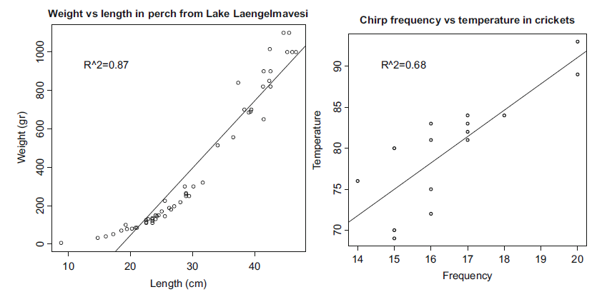
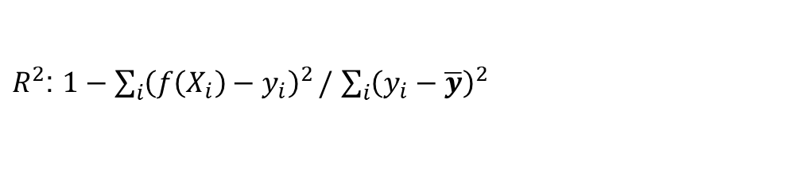
Linear regression
Examples from Forsyth AML
Fit linear coefficients to features to predict a continuous variable
R² close to zero indicates very weak relationship
R² close to 1 indicates y very linearly predictable from x
$R^{2}$: $1−\sum_{i}{{\left(f\left(X_{i}\right)−y_{i}\right)}^{2}}/$ $\sum_{i}{{\left(y_{i}−\overline{y}\right)}^{2}}$

Slide 21

Linear Logistic Regression algorithm
Training
$w^{∗}=\underset{w}{argmin}{\sum_{n}{{\left(w^{T}x−y_{n}\right)}^{2}+r(w)}}$
Prediction
$y=w^{T}x$

Slide 22
Linear regression
Model/Prediction
Training (least squares)

Slide 23

Training Linear Regression
$w^{∗}=\underset{w}{argmin}{\sum_{n}{{\left(w^{T}x−y_{n}\right)}^{2}+r(w)}}$
L2 regularization: $r\left(w\right)=λ{\left\|w\right\|}_{2}^{2}=λ\sum_{i}{w_{i}^{2}}$
L1 regularization: $r\left(w\right)=λ{\left\|w\right\|}_{1}=λ\sum_{i}{|w_{i}|}$
L2 wants no really big weights
L1 does not want a lot of little weights
L1 regularization can be used to select features
L2 linear regression is least squares and not hard to implement, but you can use a library.

Slide 24
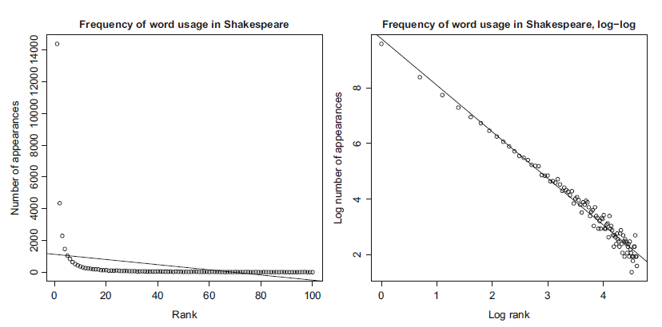
Transforming variables
Sometimes you need to transform variables before fitting a linear model
Helpful to plot histograms or distributions of individual features to figure out what transformations might apply
Example from Forsyth AML

Slide 25
Linear regression can be sensitive to outliers
There are robust forms that estimate a weight on each sample, e.g. m-estimation
Minimizing the sum of absolute error does not have this problem, but is a harder optimization
Example from Forsyth AML

Slide 26
Linear regression vs KNN vs Naïve Bayes
KNN can fit non-linear functions
Only linear regression can extrapolate
Linear regression is higher bias, lower variance
Linear regression is more useful to explain a relationship
Linear regression is more powerful (should always fit training data better, but not necessarily fit test data better) than Gaussian Naïve Bayes

Slide 27
Linear Regression Summary
Key Assumptions
y can be predicted by a linear combination of features
Model Parameters
One coefficient per feature (plus one for y-intercept)
Designs
L1 or L2 or elastic (both L1 and L2) regularization weight
Different objective functions (e.g. squared error, absolute error, m-estimation)
When to Use
Want to extrapolate
Want to visualize or quantify correlations/relationships
Have many features
When Not to Use
Relationships are very non-linear (requires transformation or feature learning first)

Slide 28
When are these used?
Logistic regression is the default classification decoder (e.g. it is the last layer of neural network classifiers)
Linear regression is used to explain data or predict continuous variables in a wide range of applications

Slide 29
Recap
Nearest neighbor is widely used
Super-powers: can instantly learn new classes and predict from one or many examples
Naïve Bayes represents a common assumption as part of density estimation, more typical as part of an approach rather than the final predictor
Super-powers: Fast estimation from lots of data; not terrible estimation from limited data
Logistic Regression is widely used
Super-powers: Effective prediction from high-dimensional features
Linear Regression is widely used
Super-powers: Can extrapolate, explain relationships, and predict continuous values from many variables
Almost all algorithms involve nearest neighbor, logistic regression, or linear regression
The main learning challenge is typically feature learning

Slide 30
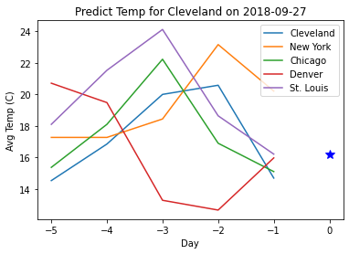
HW 1 review
MNIST Digit Classification
Predict label (0-9) from pixel intensities (784x1 vector)
Implement and test KNN, Naïve Bayes, Linear Logistic Regression
Plot Error vs Training Size
Select best parameter using validation
Temperature Regression
Predict Cleveland’s next day temperature from recent temperatures of US cities
Implement and test KNN, Naive Bayes (NB), and Linear Regression (LR)
Identify most important features with L1 linear regression, and re-train/evaluate with most important features
Stretch Goals
Improve MNIST Classification
Improve Temperature Regression
Generate a train/test classification dataset in which Naive Bayes outperforms 1-NN and Logistic Regression

Slide 31
Completing HWs
Read assignment and tips
Code by adding to starter code notebook (which mainly has data loading and visualization functions)
Complete report, including expected points
Submit the report, notebook pdf/html, and zipped code
Mainly grader will look at report first, notebook pdf for clarification, and zipped code rarely
Notebook does not need to include all outputs

Slide 32
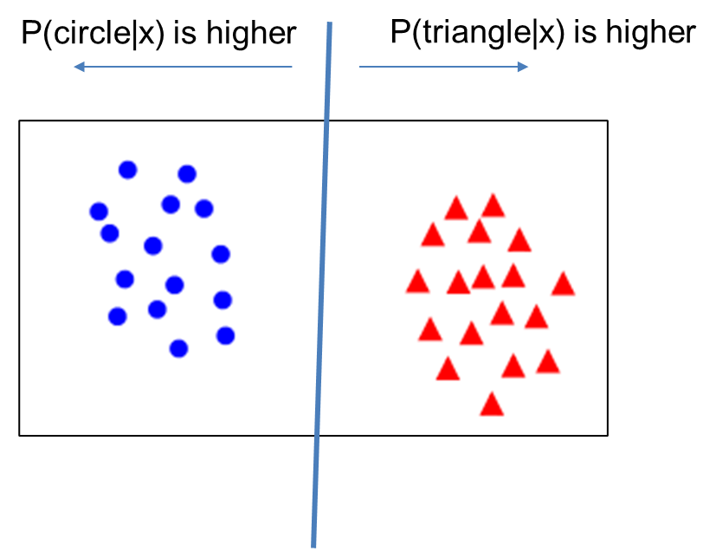
Things to remember
Linear logistic regression is a classification technique that aims to split features between two classes with a linear model
Predict categorical values with confidence
Linear regression fits a linear model to a set of feature points to predict a continuous value
Explain relationships
Predict values
Extrapolate observations
Nearest neighbor and linear models are the final predictors of most ML algorithms – the complexity lies in finding features that work well with NN or linear models

Slide 33
Next week
Trees
Ensembles

